Slide 1


R Markdown for Reproducible Research

Slide 2
Outline
What is Reproducibility
Why R Markdown
Tips and Tricks

Slide 3
What is Reproducibility?
A result is reproducible if it can be reliably replicated or recomputed in another time or place.

Slide 4

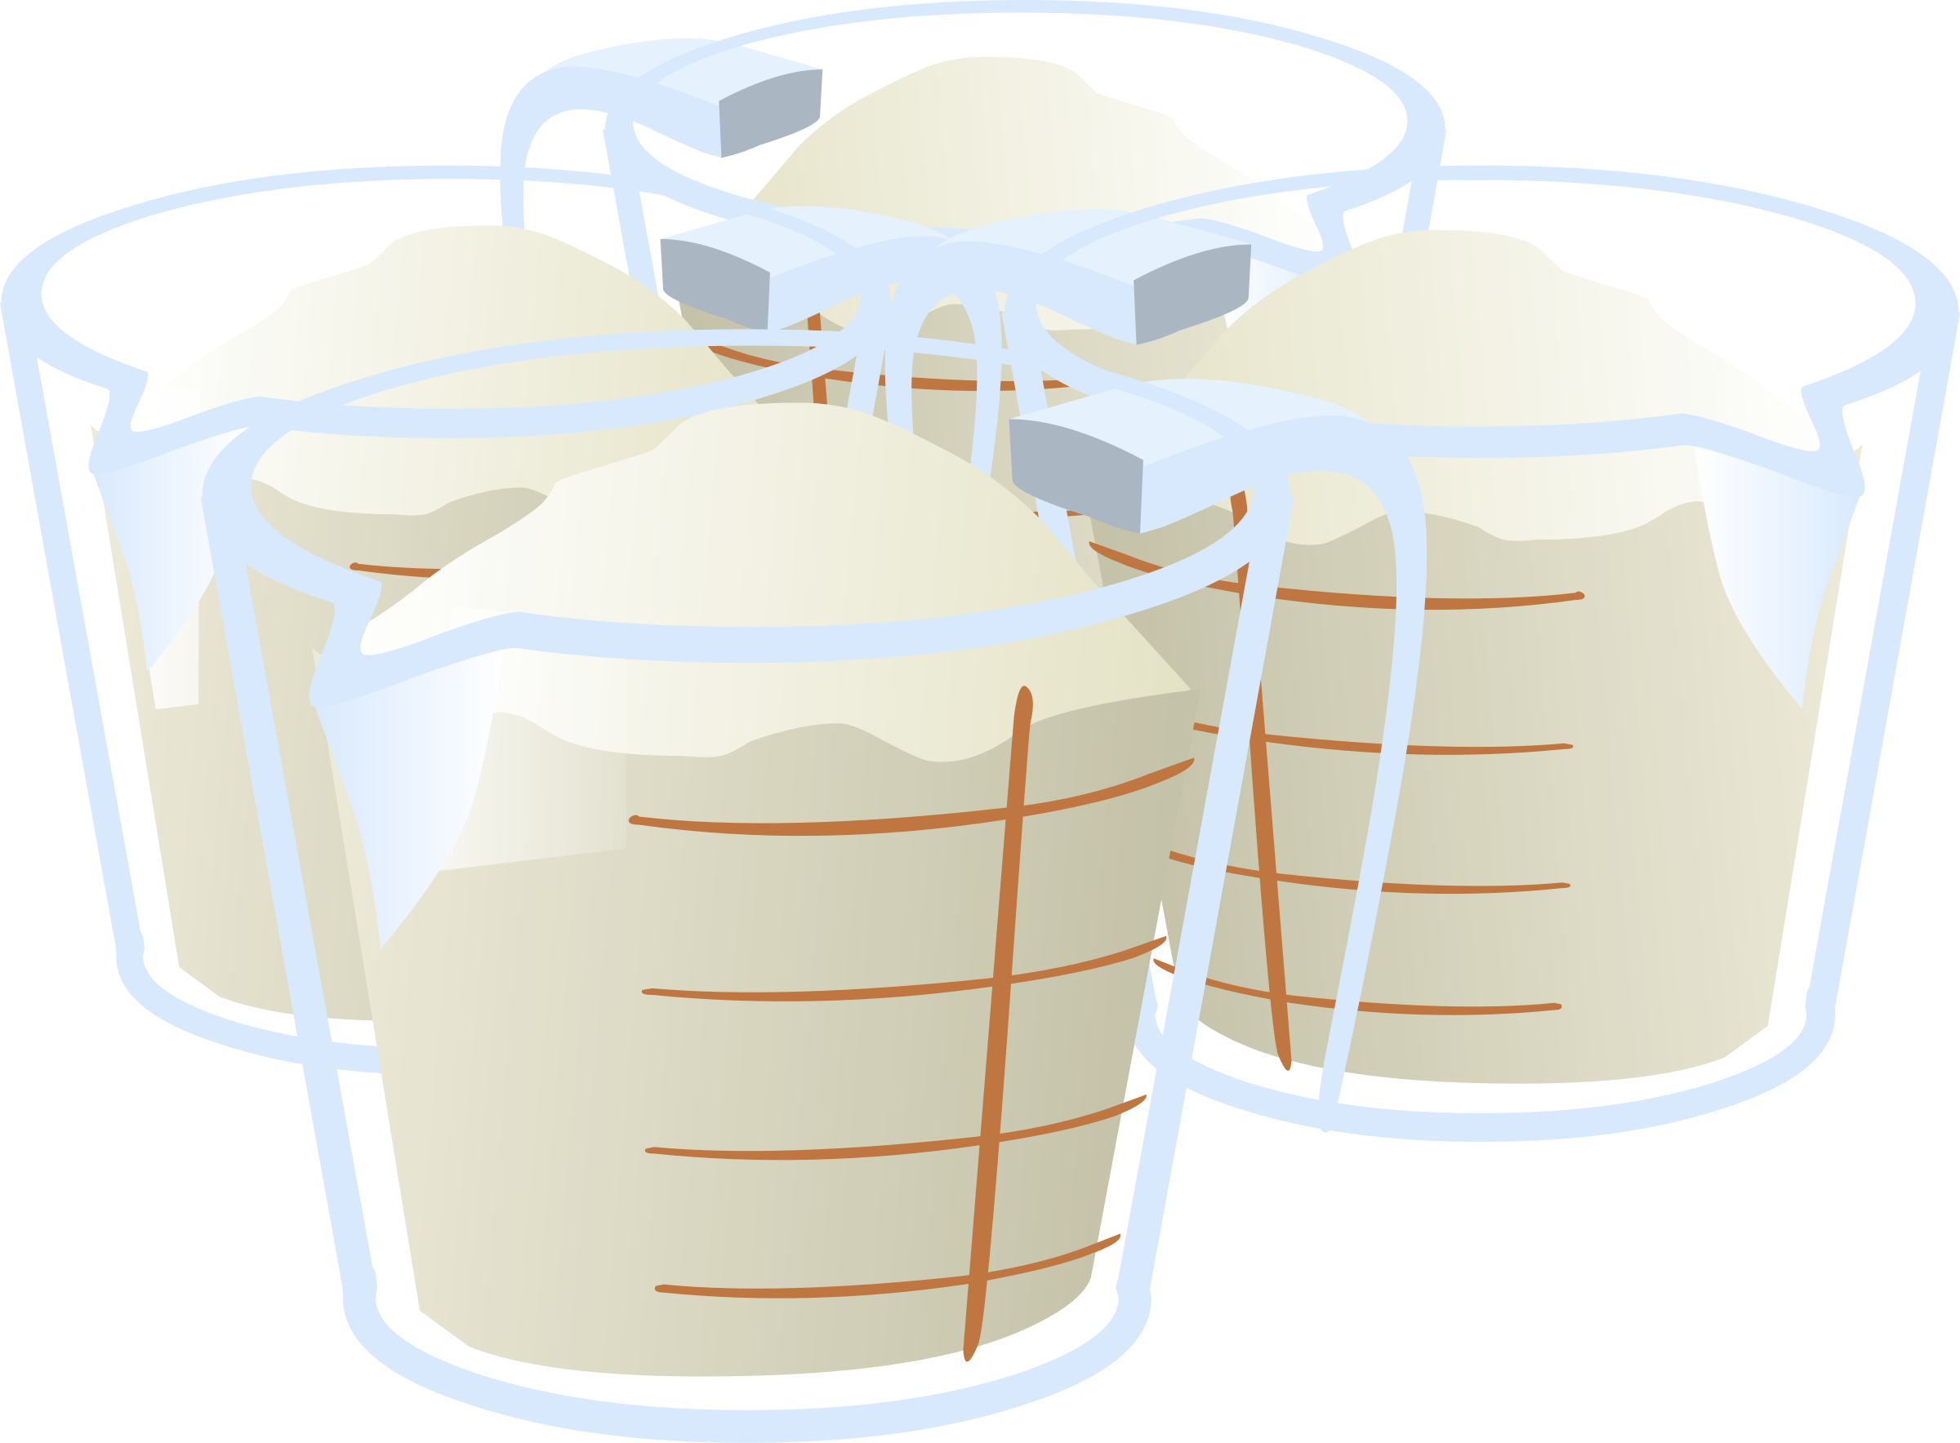

What is Reproducibility?
Ingredients
Process
Result

Slide 5


A Motivational Example

Slide 6
A Motivational Example

Slide 7
A Motivational Example

Slide 8
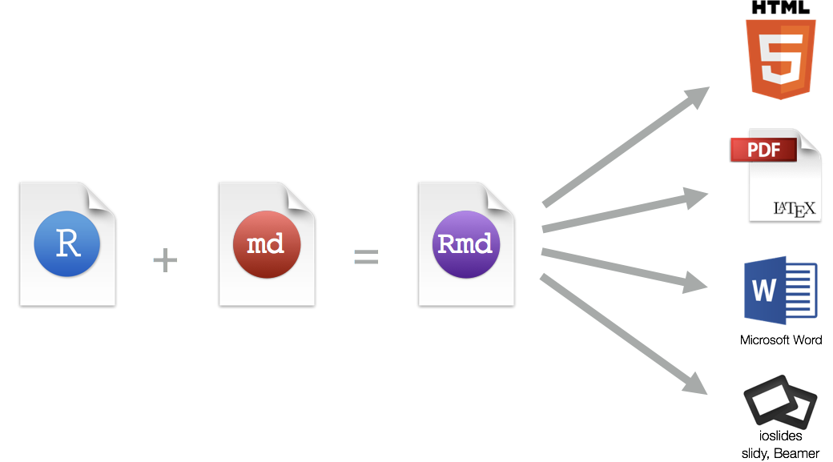
What is R Markdown?
Microsoft PowerPoint

Slide 9
What is R Markdown?
Ingredients
Process
Result

Slide 10







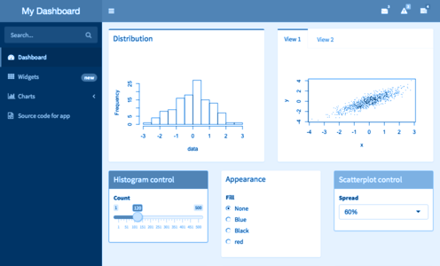
What is R Markdown?
Ingredients
Process
Result

Slide 11
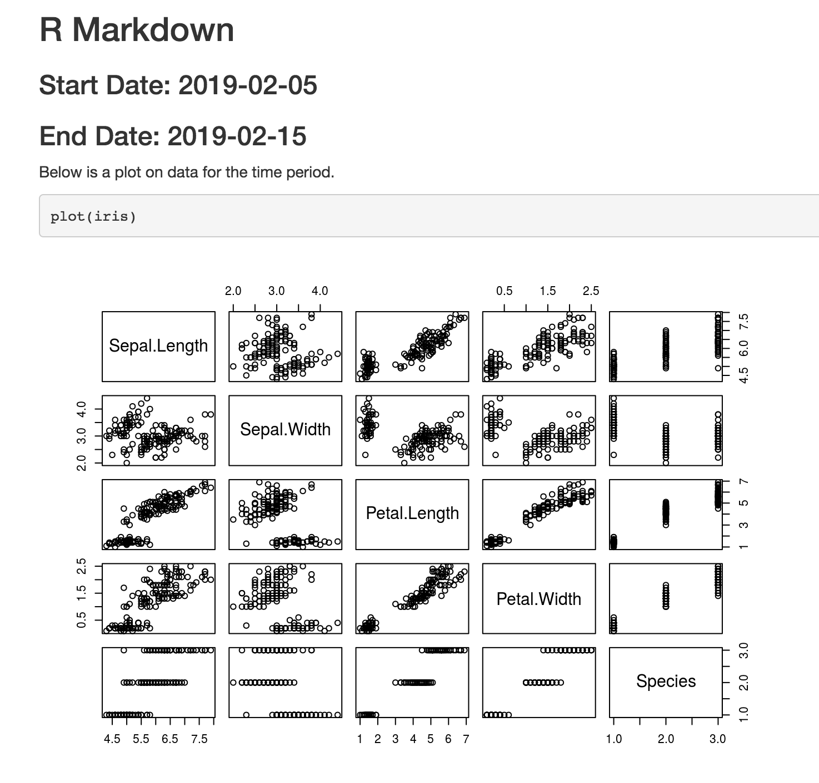
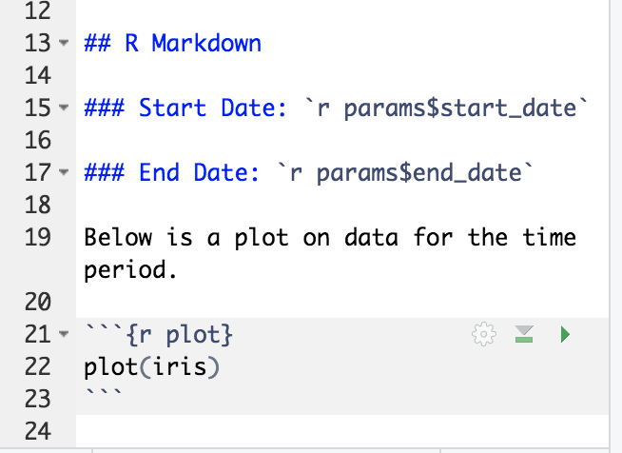
How does it help?

Slide 12
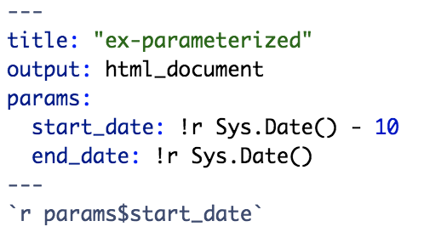
Parameterized R Markdown

Slide 13
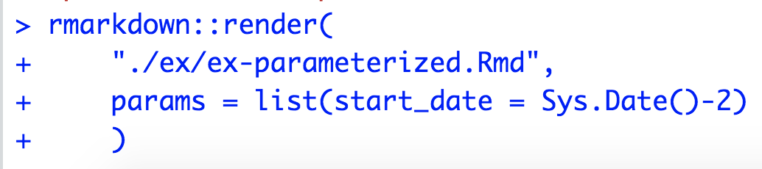
Parameterized R Markdown

Slide 14
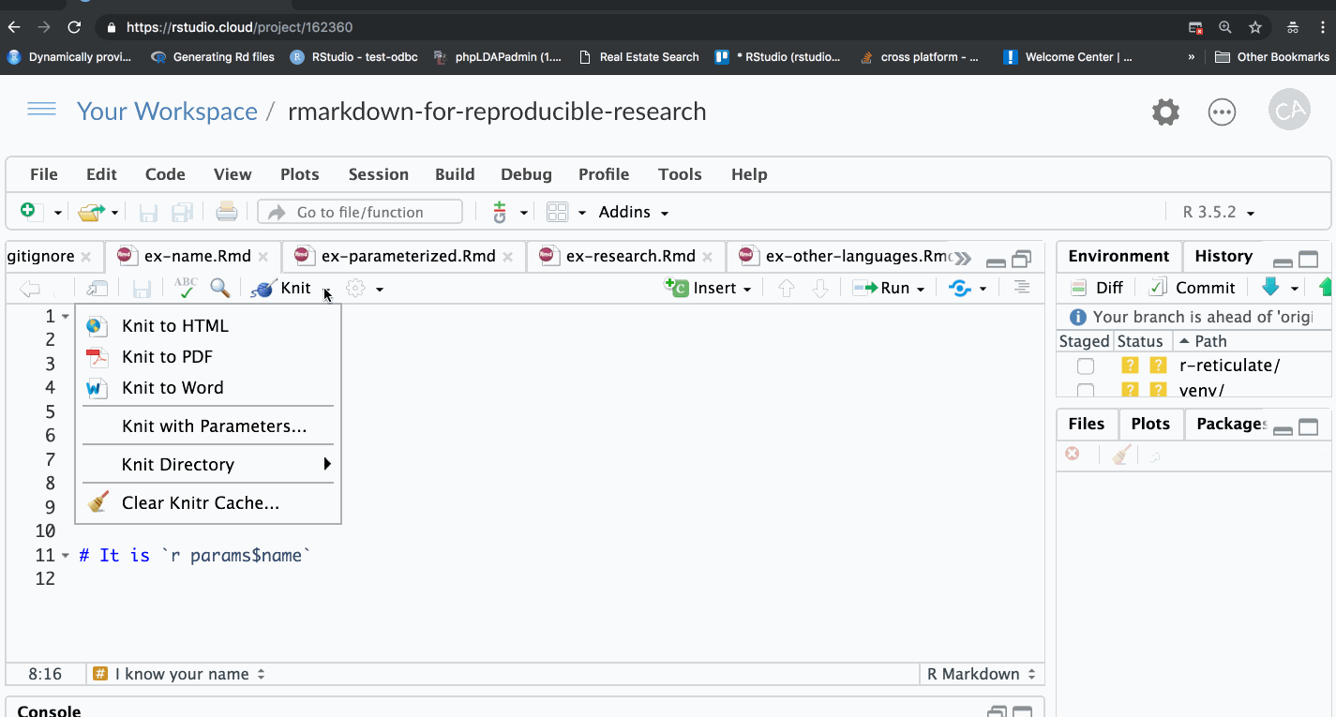
Parameterized R Markdown

Slide 15





Including Python (or other languages)

Slide 16
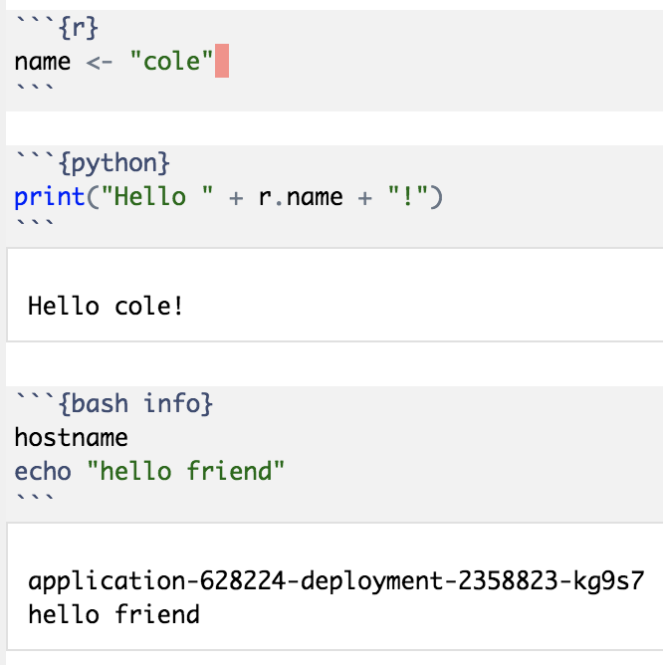

Slide 17

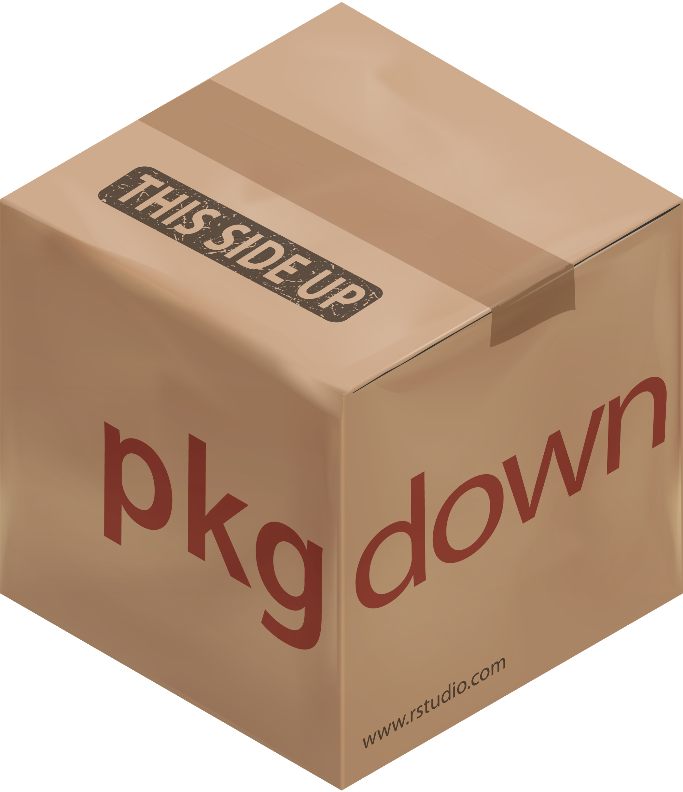



All Output Types
Websites
blogdown, bookdown, pkgdown, HTML
Documents
PDF, Word, HTML, Pagedown
Slides
PowerPoint, HTML (ioslides, Slidy, xaringan), PDF (Beamer)
Apps / Dashboards
Shiny, flexdashboard

Slide 18



Deployment, Automation, Distribution
Consumers
Creators

Slide 19
Deployment, Automation, Distribution
Central content / publishing portal
Cut down on version changes
Lower bar for non-programmers
Schedule content to refresh automatically
Interact with content (change parameters, etc.)
Customized emails using rmarkdown::output_metadata
blastula package

Slide 20
Summary
R Markdown helps reproduce your entire result
Parameters help you easily specify inputs
R Markdown is language agnostic

Slide 21
Stay in Touch
RStudio Community - http://rstd.io/community
Developer Blog - http://rstd.io/dev-blog
R Views Blog - http://rstd.io/rviews-blog
TensorFlow Blog - http://rstd.io/tf-blog
Twitter - http://rstd.io/twitter
GitHub - http://rstd.io/github
LinkedIn - http://rstd.io/linkedin
YouTube - http://rstd.io/youtube
Facebook - http://rstd.io/facebook

Slide 22
Questions
One sentence and end in a “?”

